Slide 1

Python Workshop – Day 2
Department: ASBS / Accounting & Finance
Zhonghao Jiang z.jiang.1@research.gla.ac.uk
4 Nov 2022

Slide 2
Today
An A
1

Slide 3
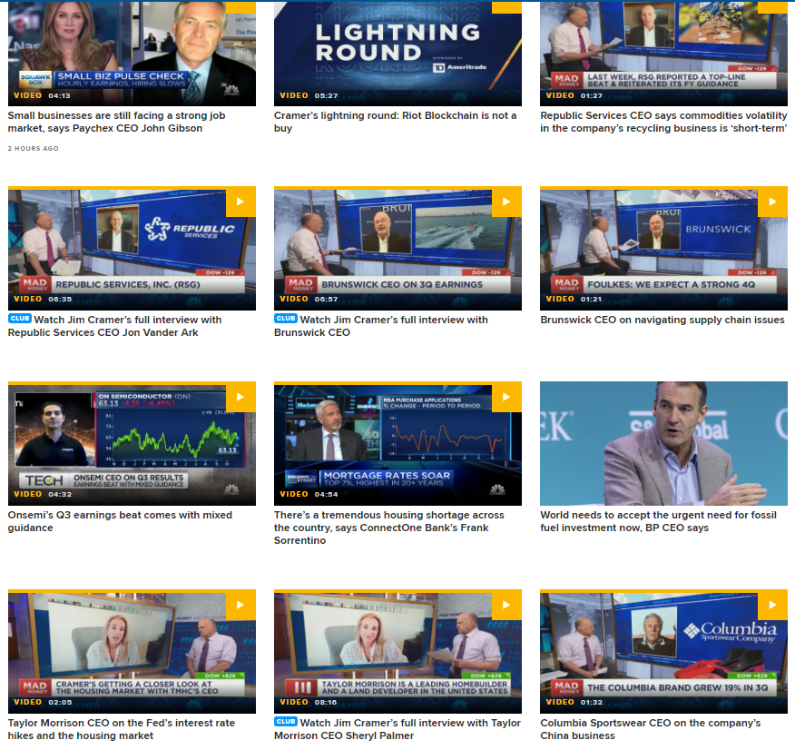
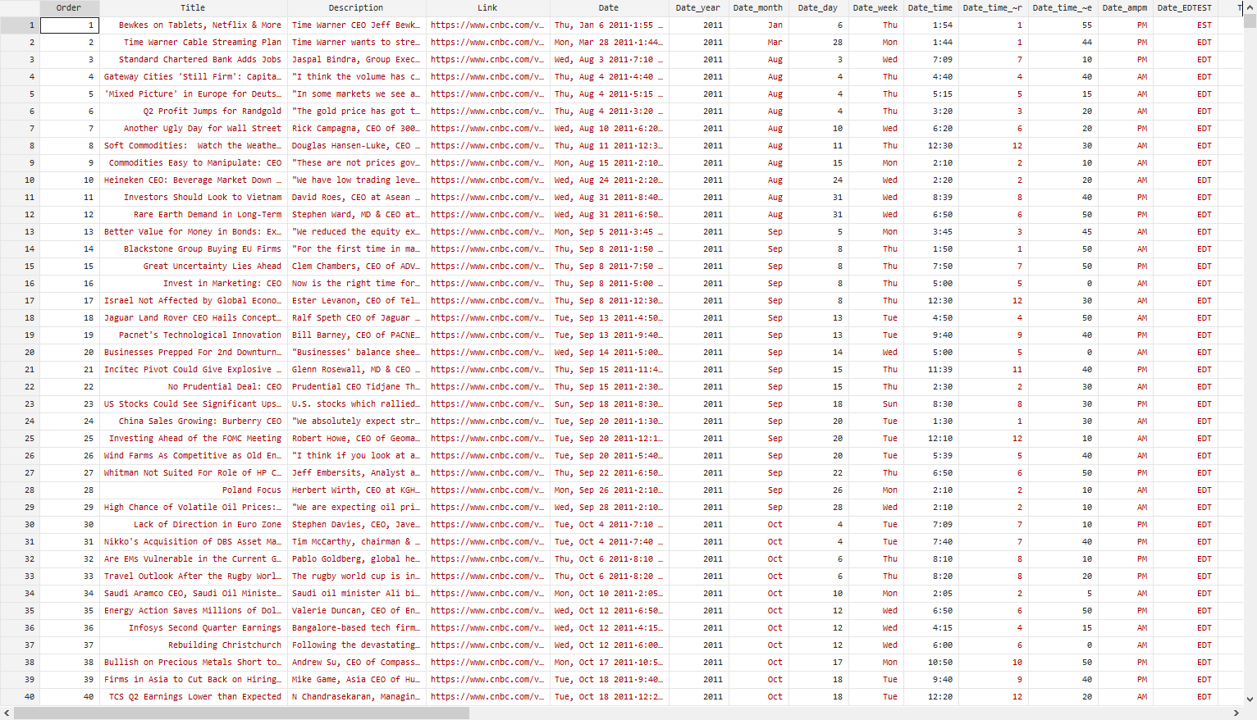
What is (web) scraping in Python?
An automated method to extract large amount of information from the websites. — Imitating artificial collection process by coding Achieve a transform from unstructured data to structured data.
1

Slide 4
Application in our research
1. Data collection: — Calculating investor sentiments using Reviews from StockTwits (Cookson & Niessner, 2020) — Calculating investor sentiments using Images from financial news (Obaid and Pukthuanthong, 2022) — Examining the social media effect using Employees Review from Glassdoor.com (Allen et al., 2021)
1

Slide 5
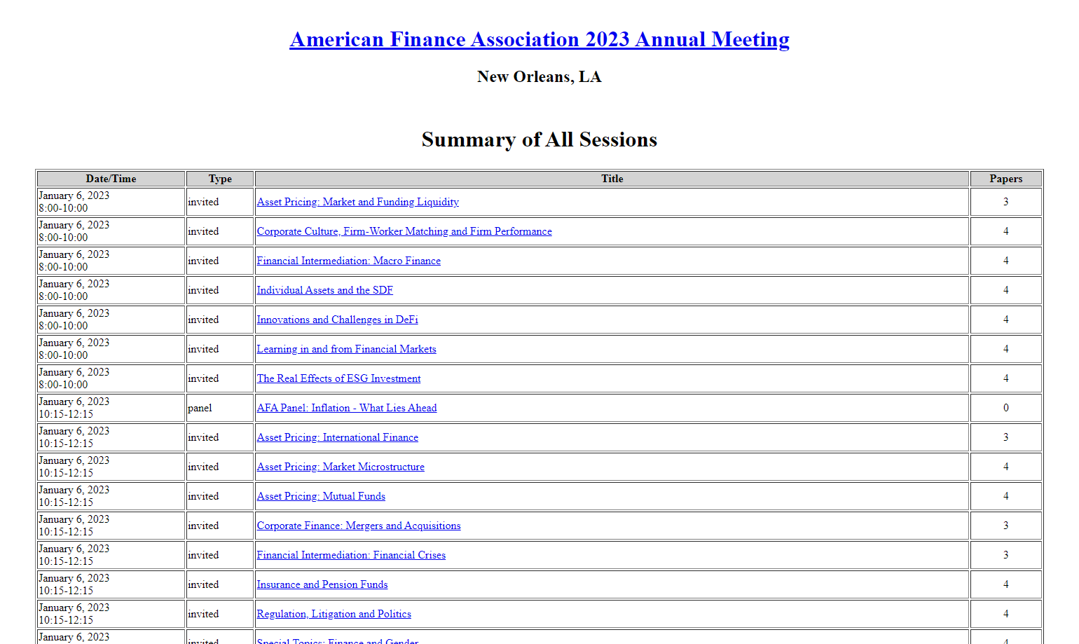
Application in our research (cont.)
2. Literature searching or downloading in bulk from Scholar, Conference websites, etc.
3. Auto-processing some repetitive works such as renaming files, filling forms PC can work when we sleep, Save time
1

Slide 6
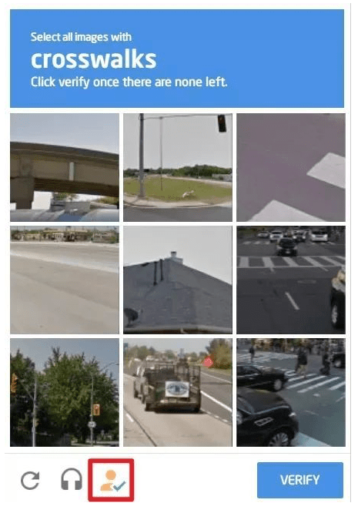
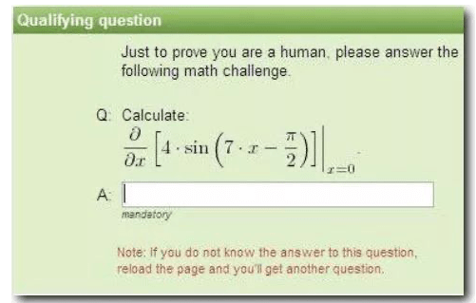
Is it legal?
Potential Risks: — some codes disturb the operation of the websites — legally protected data: Paypal users private information — some websites have anti-scraping tools — moral risk: tickets
Legally use the data scraped.
1

Slide 7
Scraping methods
Writing our own codes
API (application programming interface) — procedures and communication protocols that provide a direct access to the data usually provided by data provides themselves — why data providers provide API for others: fees; visits (ads?)
Third party apps or extensions
1

Slide 8
I. Basic Codes Writing
1

Slide 9
1.1 Requests
1

Slide 10
Steps for basic requests
1. Web targeting: url
2. Web request
3. Response obtain
4. Data save
1

Slide 11
Step 1. Web targeting
http (Hypertext Transfer Protocol) — a communication between web clients and web servers — web servers: response; web clients: request
Request headers — User-Agent: ID for the current request — Connection: After the request, keep the links or stop the links
Response headers — Content-Type: the response types
1

Slide 12
Step 1. Web targeting (cont.)
Web page Inspect
HTML (HyperText Markup Language) for webs <div class="foo">Content</div> start attribute content end example: https://www.bbc.co.uk/sport/football/63469211
1

Slide 13
Steps 2-4
Python modules/packages for request: — pip install requests (like ssc install in STATA)
Practice1: demo1.py — Target: Download and save a web page Practice2: demo2.py — Target: Download and save a web page for google search result
1

Slide 14
Data Parsing
Until now, we know how to send a request and obtain the response (file: *.html)
It is the process of transforming unstructured/unreadable data to structured/readable data For example, from *.html to a PDF, to a jpg, to a csv file.
Usually focus on part of the web page instead of the whole page
1

Slide 15
Data Parsing (cont.)
Same steps — finding the url/tag/attribute of the content — request — response — save
Three methods to achieve data parsing — regular expression — bs4 — xpath
1

Slide 16
Data Parsing Practice
Practice3 demo3.py — download and save one picture from the website
Practice4 demo4.py — download and save pictures from the website using Regular Expression
before the practice4:
1

Slide 17
Regular Expression
A regular expression is a sequence of characters that specifies a search pattern in text.
* zero or more occurrences of the preceding element + one or more occurrences of the preceding element . any elements except /n ? Non-greedy mode of the preceding character (* or +) — Example: <src = ‘https: //1.jpg’ width = ‘16’> src = ‘.*’ matches src = ‘https: //1.jpg’ width = ‘16’ src = ‘.*?’ matches src = ‘https://1.jpg’
And so on…
1

Slide 18
Regular Expression (cont.)
Which can be expressed by ‘py*n’ (multiple selection) A. pn B. pyn C. python D. pyyyyyyyyyn
Which can be expressed by ‘py+n’ (multiple selection) A. pn B. pyn C. python D. pyyyyyyyyyn
1

Slide 19
Regular Expression (cont.)
Python module for regular expression is re
Functions: re.findall(expression, string[,flags]) re.search(expression, string[,flags]) re.split(expression, string[, maxsplit=0])
Flags re.L re.S re.U re.l re.X re.M
Return to practice4
1

Slide 20
Regular Expression Practice (cont.)
Try1: Please record the following information of all the staff at Adam Smith Business School, using requests module and re module: — 1. Names saving as Name.txt under the folder STAFF
1

Slide 21
In the future
bs4 data parsing using BeautifulSoup module
xpath data parsing
1

Slide 22
1.2 Selenium
1

Slide 23
Selenium Module
What is Selenium Selenium is an open-source tool that automates web browsers.
Why Selenium? — 1.difficult to find some contents of the websites — 2. login needed — 3. dynamic websites — 4. automation needed
1

Slide 24
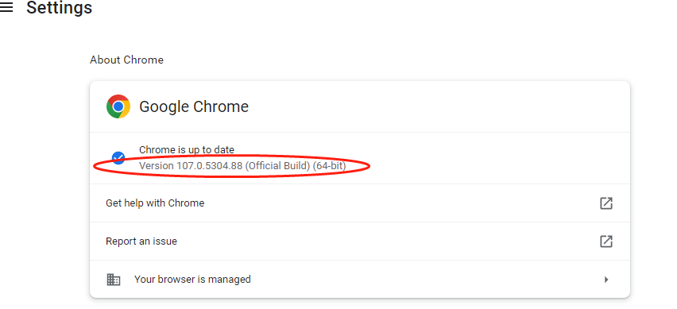
Launch browser
Install selenium — pip install selenium
Download a driver of your preferred browser — check the version of the browser — google ‘webdriver for Chrome’ — download the driver and extract the zip.file
Launch browser in Selenium WebDriver — web = webdriver.Chrome(excutable_path = ‘the driver address’)
1

Slide 25
Interactions
Requests: get(url)
Find the positions of the elements: find_element()
Page back, Page forward: back(), forward()
Searching interactions: send_keys(‘’)
Close the browser: quit()
1

Slide 26
Practice
demo5: find the papers from google scholar
Try2: — please try to login MyCampus using selenium Try3： — please download photos for each staff at the Adam Smith Business School
1

Slide 27
II. API
1

Slide 28
What is API
API (application programming interface) — procedures and communication protocols that provide a direct access to the data usually provided by data provides themselves
1

Slide 29
API scraping example
Glassdoor.com https://www.page2api.com/blog/how-to-scrape-glassdoor-reviews/
1

